Slide 1
The Theatre Royal Booking Application
Technical Presentation

Slide 2
Devising a plan
Decide how the team would
Communicate – Slack
Manage version control – GitHub
Manage how we would work alongside each other and distribute tasks
Trello
Organise and share schedules
Team meeting every night to discuss progress, focus of the next day
Upon receiving the design specification and Moscow requirements
Break down the requirements and milestones into concise objectives
Order objectives into logical steps

Slide 3
Where to start?
Design the ERD
Figure out what data we would want to store based on the specifications
Go through the ‘normalisation’ process to make the data efficient with as little duplication as possible
Revisit this as we progress
Design the conversation between the program and the user
How the conversation would develop
Design the class diagram
Figure out the main ‘model’ of the Theatre
Aka ’physical entities’ of the theatre (show, performances, tickets, a checkout/basket)
The front-end controller and back-end controller
The Database Connection class
Utility classes needed
Classes that will control how we get data such as date/time, how we format certain Strings

Slide 4
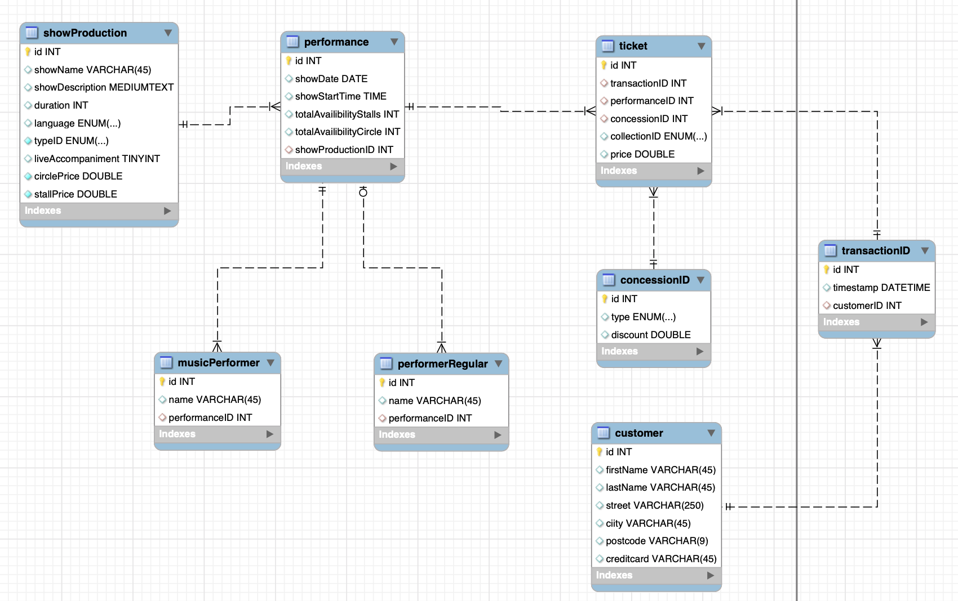
ERD

Slide 5
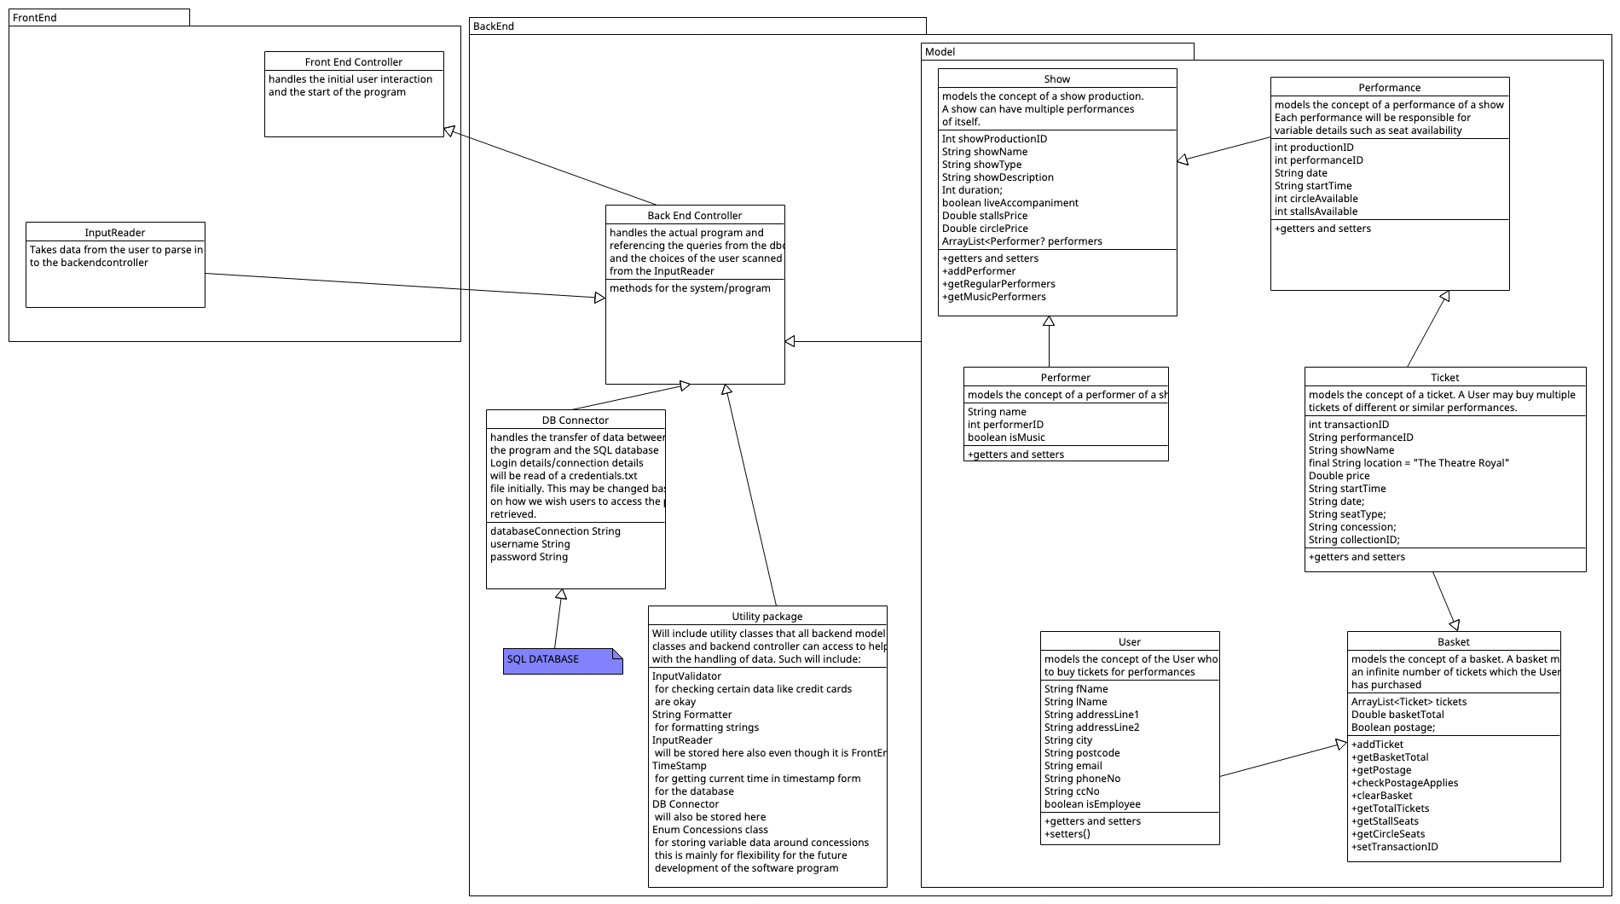
Class Diagram

Slide 6
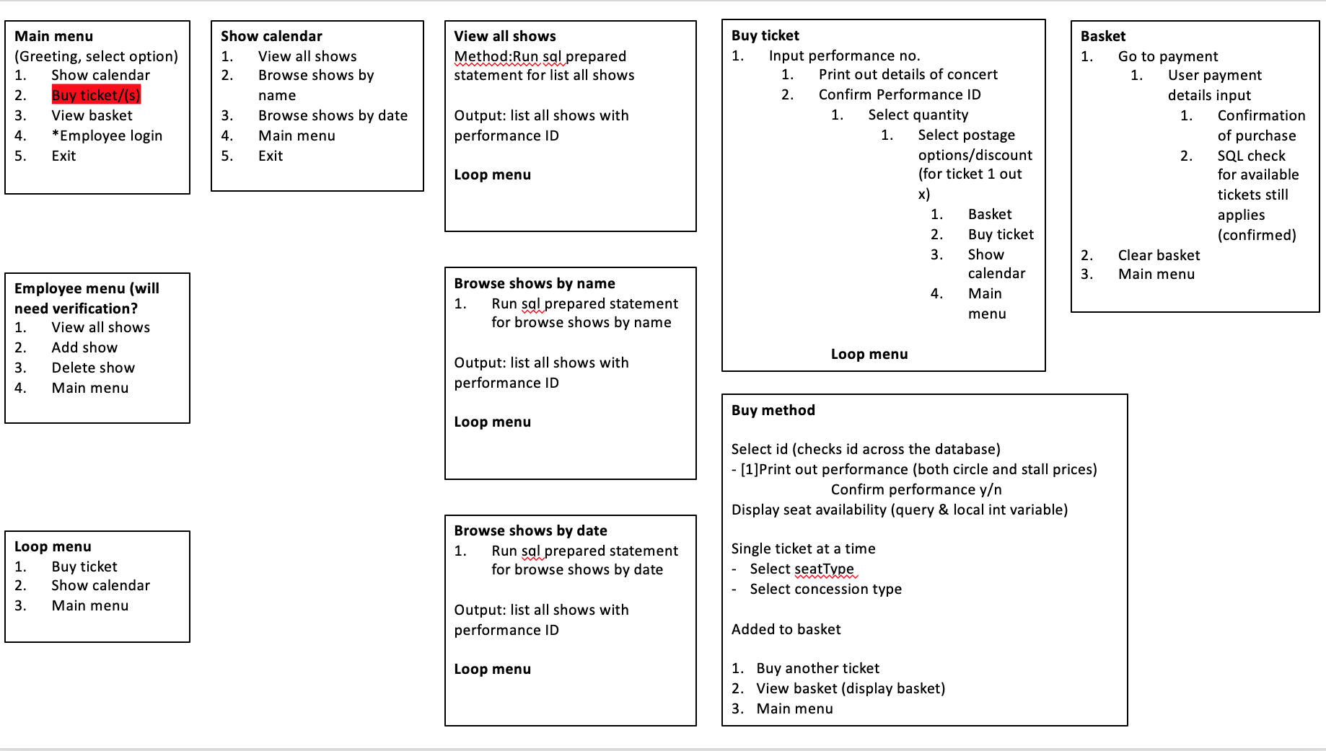
Controller Branch (Conversation with the User)

Slide 7
Design philosophy
Design the program to be

